Slide 1


2021 Google Solution Challenge

Slide 2
Solution Challenge
Enabling student developers across the globe to build real solutions for real problems.
Notes:
Danny
Greetings
Welcome everyone to join our Info Session Solution Challenge today
We’re so happy to be here and share with you one of our biggest event hosted by DSC around the world.

Slide 3
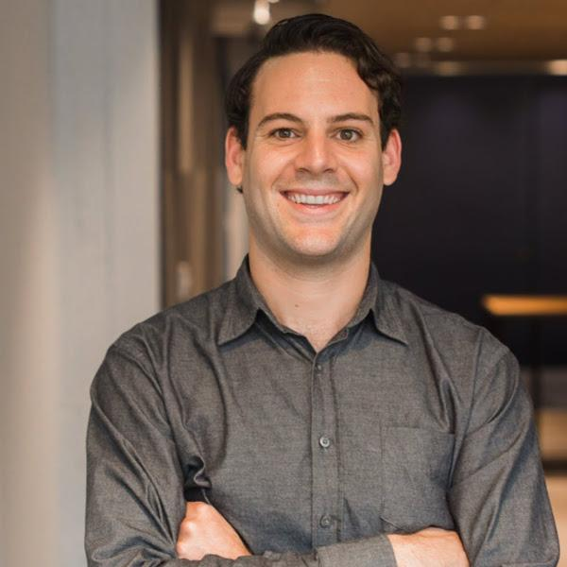

Daniel Fiorillo: or Danny
DSC Community Manager
LinkedIn Profile:
https://www.linkedin.com/in/djf19/
Twitter:
@SazzPapa
Notes:
Danny

Slide 4
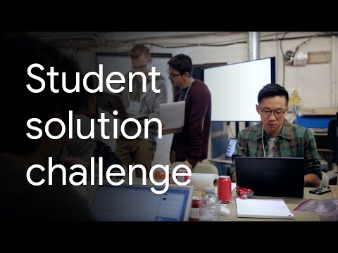
Notes:
Play video - comment on it

Slide 5
What is it?
This sounds interesting...
An annual contest that invites students from DSC communities to develop solutions for local community problems using one or more Google products or platforms.
Notes:
Danny

Slide 6
Why do it?
I can get behind this!
Enable hands-on learning and inspire student developers to come together as a global community, learn, and build real solutions for real problems.
Notes:
Danny We want to enable hands on learning and inspire student developers to come together as a global community. To learn, and build real solutions for real problems. This is your opportunity to participate in a real world developer cycle.

Slide 7
When does it start?
We are getting excited...
January 2021
Notes:
Danny
Registrations will be rolling so students from all regions can join (irrespective of holidays/ exams etc) The form is expected to be available for everyone to officially sign up for participation from January 2021. However, you can start forming teams and building your project ideas from now on.

Slide 8
When does it End?
We are getting excited...
March 2021
Notes:
Danny
Registrations will be rolling so students from all regions can join (irrespective of holidays/ exams etc) The form is expected to be available for everyone to officially sign up for participation from January 2021. However, you can start forming teams and building your project ideas from now on.

Slide 9
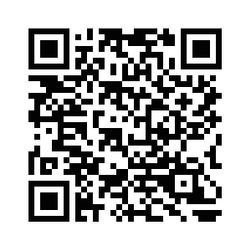
How will we build things?
The DSC Solution Challenge
This is an annual competition open to DSC Leads, Core Team members and others building solutions under mentorship umbrella of a DSC. The solution must be built on Google's technologies and must address a local problem faced by a business, organization, NGO etc. Registration opens early January 2021.
Scan me for more information!
Notes:
The next component of what our club does is “build.” I would like to invite Danny to talk a little bit about the upcoming 2021 DSC Solution Challenge.

Slide 10
Rules
Must be over 18
4 team members [max]
Must be a DSC member of any university
Use at least 1 Google technology
Project must be built during your academic year
More at https://events.withgoogle.com/dsc-solution-challenge/
Notes:
Danny

Slide 11
Evaluation Criteria
And… the winners are...
Impact [50]
Technology [40]
Scalability [10]
Does the entry establish a clear challenge faced in the team’s local community? Is it explained in a clear manner? [10]
Is there evidence that the solution has been thoroughly tested with real users? [10]
Is there evidence that the solution was iterated upon based on user feedback? [10]
Will this solution improve people’s lives? [10]
Is there evidence of a next step… does the team display a plan for future extension if they were to continue [10]
Does the solution address the challenge identified by the team? [10]
Does the solution make effective/ appropriate use of the features of the chosen Google Product or platform? [10]
Does the video demonstration show the working application and how a user will interact with the solution? [10]
Has the team clearly explained what Google technology they used, why and included guidance on how to run their code? [10]
If successful, can the solution be scaled using the cloud technology infrastructure for more users and in other regions? [10]
Notes:
Impact. [50%]
Does the entry establish a clear challenge faced in the team’s local community? Is it explained in a clear manner? [10]
Is there evidence that the solution has been thoroughly tested with real users? [10]
Is there evidence that the solution was iterated upon based on user feedback? [10]
Will this solution improve people’s lives? [10]
Is there evidence of a next step… does the team display a plan for future extension if they were to continue [10]
Technology [40%]
Does the solution address the challenge identified by the team? [10]
Does the solution make effective/ appropriate use of the features of the chosen Google Product or platform? [10]
Does the video demonstration show the working application and how a user will interact with the solution? [10]
Has the team clearly explained what Google technology they used, why and included guidance on how to run their code? [10]
Scalability [10%]
If successful, can the solution be scaled using the cloud technology infrastructure for more users and in other regions? [10]

Slide 12
Evaluation Criteria
And… the winners are...
Impact [50]
Technology [40]
Scalability [10]
Does the entry establish a clear challenge faced in the team’s local community? Is it explained in a clear manner? [10]
Is there evidence that the solution has been thoroughly tested with real users? [10]
Is there evidence that the solution was iterated upon based on user feedback? [10]
Will this solution improve people’s lives? [10]
Is there evidence of a next step… does the team display a plan for future extension if they were to continue [10]
Does the solution address the challenge identified by the team? [10]
Does the solution make effective/ appropriate use of the features of the chosen Google Product or platform? [10]
Does the video demonstration show the working application and how a user will interact with the solution? [10]
Has the team clearly explained what Google technology they used, why and included guidance on how to run their code? [10]
If successful, can the solution be scaled using the cloud technology infrastructure for more users and in other regions? [10]
Notes:
Impact. [50%]
Does the entry establish a clear challenge faced in the team’s local community? Is it explained in a clear manner? [10]
Is there evidence that the solution has been thoroughly tested with real users? [10]
Is there evidence that the solution was iterated upon based on user feedback? [10]
Will this solution improve people’s lives? [10]
Is there evidence of a next step… does the team display a plan for future extension if they were to continue [10]
Technology [40%]
Does the solution address the challenge identified by the team? [10]
Does the solution make effective/ appropriate use of the features of the chosen Google Product or platform? [10]
Does the video demonstration show the working application and how a user will interact with the solution? [10]
Has the team clearly explained what Google technology they used, why and included guidance on how to run their code? [10]
Scalability [10%]
If successful, can the solution be scaled using the cloud technology infrastructure for more users and in other regions? [10]

Slide 13
Evaluation Criteria
And… the winners are...
Impact [50]
Technology [40]
Scalability [10]
Does the entry establish a clear challenge faced in the team’s local community? Is it explained in a clear manner? [10]
Is there evidence that the solution has been thoroughly tested with real users? [10]
Is there evidence that the solution was iterated upon based on user feedback? [10]
Will this solution improve people’s lives? [10]
Is there evidence of a next step… does the team display a plan for future extension if they were to continue [10]
Does the solution address the challenge identified by the team? [10]
Does the solution make effective/ appropriate use of the features of the chosen Google Product or platform? [10]
Does the video demonstration show the working application and how a user will interact with the solution? [10]
Has the team clearly explained what Google technology they used, why and included guidance on how to run their code? [10]
Can the technology, in its current form or with minor structural changes, support more users, new regions, and increased scale often attributed with success and growth? [10]"
Notes:
Impact. [50%]
Does the entry establish a clear challenge faced in the team’s local community? Is it explained in a clear manner? [10]
Is there evidence that the solution has been thoroughly tested with real users? [10]
Is there evidence that the solution was iterated upon based on user feedback? [10]
Will this solution improve people’s lives? [10]
Is there evidence of a next step… does the team display a plan for future extension if they were to continue [10]
Technology [40%]
Does the solution address the challenge identified by the team? [10]
Does the solution make effective/ appropriate use of the features of the chosen Google Product or platform? [10]
Does the video demonstration show the working application and how a user will interact with the solution? [10]
Has the team clearly explained what Google technology they used, why and included guidance on how to run their code? [10]
Scalability [10%]
If successful, can the solution be scaled using the cloud technology infrastructure for more users and in other regions? [10]

Slide 14

Terms & Conditions
Bookmark this!
goo.gle/solutionchallenge/
Notes:
Danny For more details on term and condition, make sure to check out the content site: goo.gle/solutionchallenge

Slide 15
Timeframe and Important dates
Google Solution Challenge 2021
(Tuan)
Judging
Each entry will be judged by a panel of experts from Sponsor or Google Developer Expert program
The contest begin
????
???
March ??
Jan ??
????
The contest end
All entries must be submited by 11:59 p.m (PT)
Selection day
10 entries receive the highest overall scores will be selected as potential winner
Demo day
Notes:
The timeline and agenda for the next google solution challenge is not officially posted, but as far as we know, the contest will begin around January and end around March/ April. The next phase will be Judging, where each entry will be judged by a panel of expert from Sponsor or Google Developer Expert Program. Afterward is the selection day, where top 10 entries with highest score will be selected as potential winner. Finally, the demo day where top 10 will meet together at a huge event with Google and Sponsor, watched all over the world

Slide 16
Timeframe and Important dates
Google Solution Challenge 2021
(Tuan)
To find out when important dates are released for this year’s Solution Challenge, bookmark the Official Solution Challenge website and check regularly for updates, and join the PSU DSC.
Notes:
Keep in mind with the website, subcribe to your DSC which our is Portland State University DSC, we will notify you asa google solution challenge is published

Slide 17
Benefits of Participating
In the Solution Challenge 2021
(Tuan)
Networking with Googlers, Experts and big companies
Mentor from Google Expert Program
Use Google technology for free
Learn new skills and technologies
Push yourself out of comfort zone
Actually build an amazing project
Many more opportunities...
Notes:
By participating in Google Solution Challenge, it’s time for you to build your network with Googler/Exp. Networking is super important. You will receive guidance from Mentor at Google, to make your idea into real project that solve realistic problem. Recruiter from tech companies, they love to know what have you built during your school time, and its a huge evaluation for them.

Slide 18
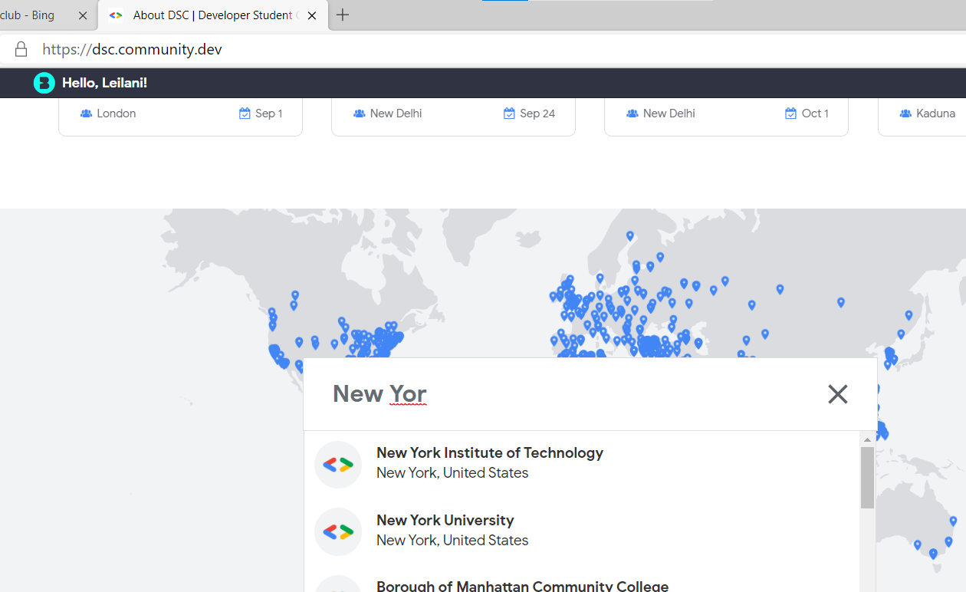
How to Register with a DSC
(Tuan)
Go to dsc.community.dev

Slide 19

How to Register with a DSC
(Tuan)
Go to dsc.community.dev

Slide 20
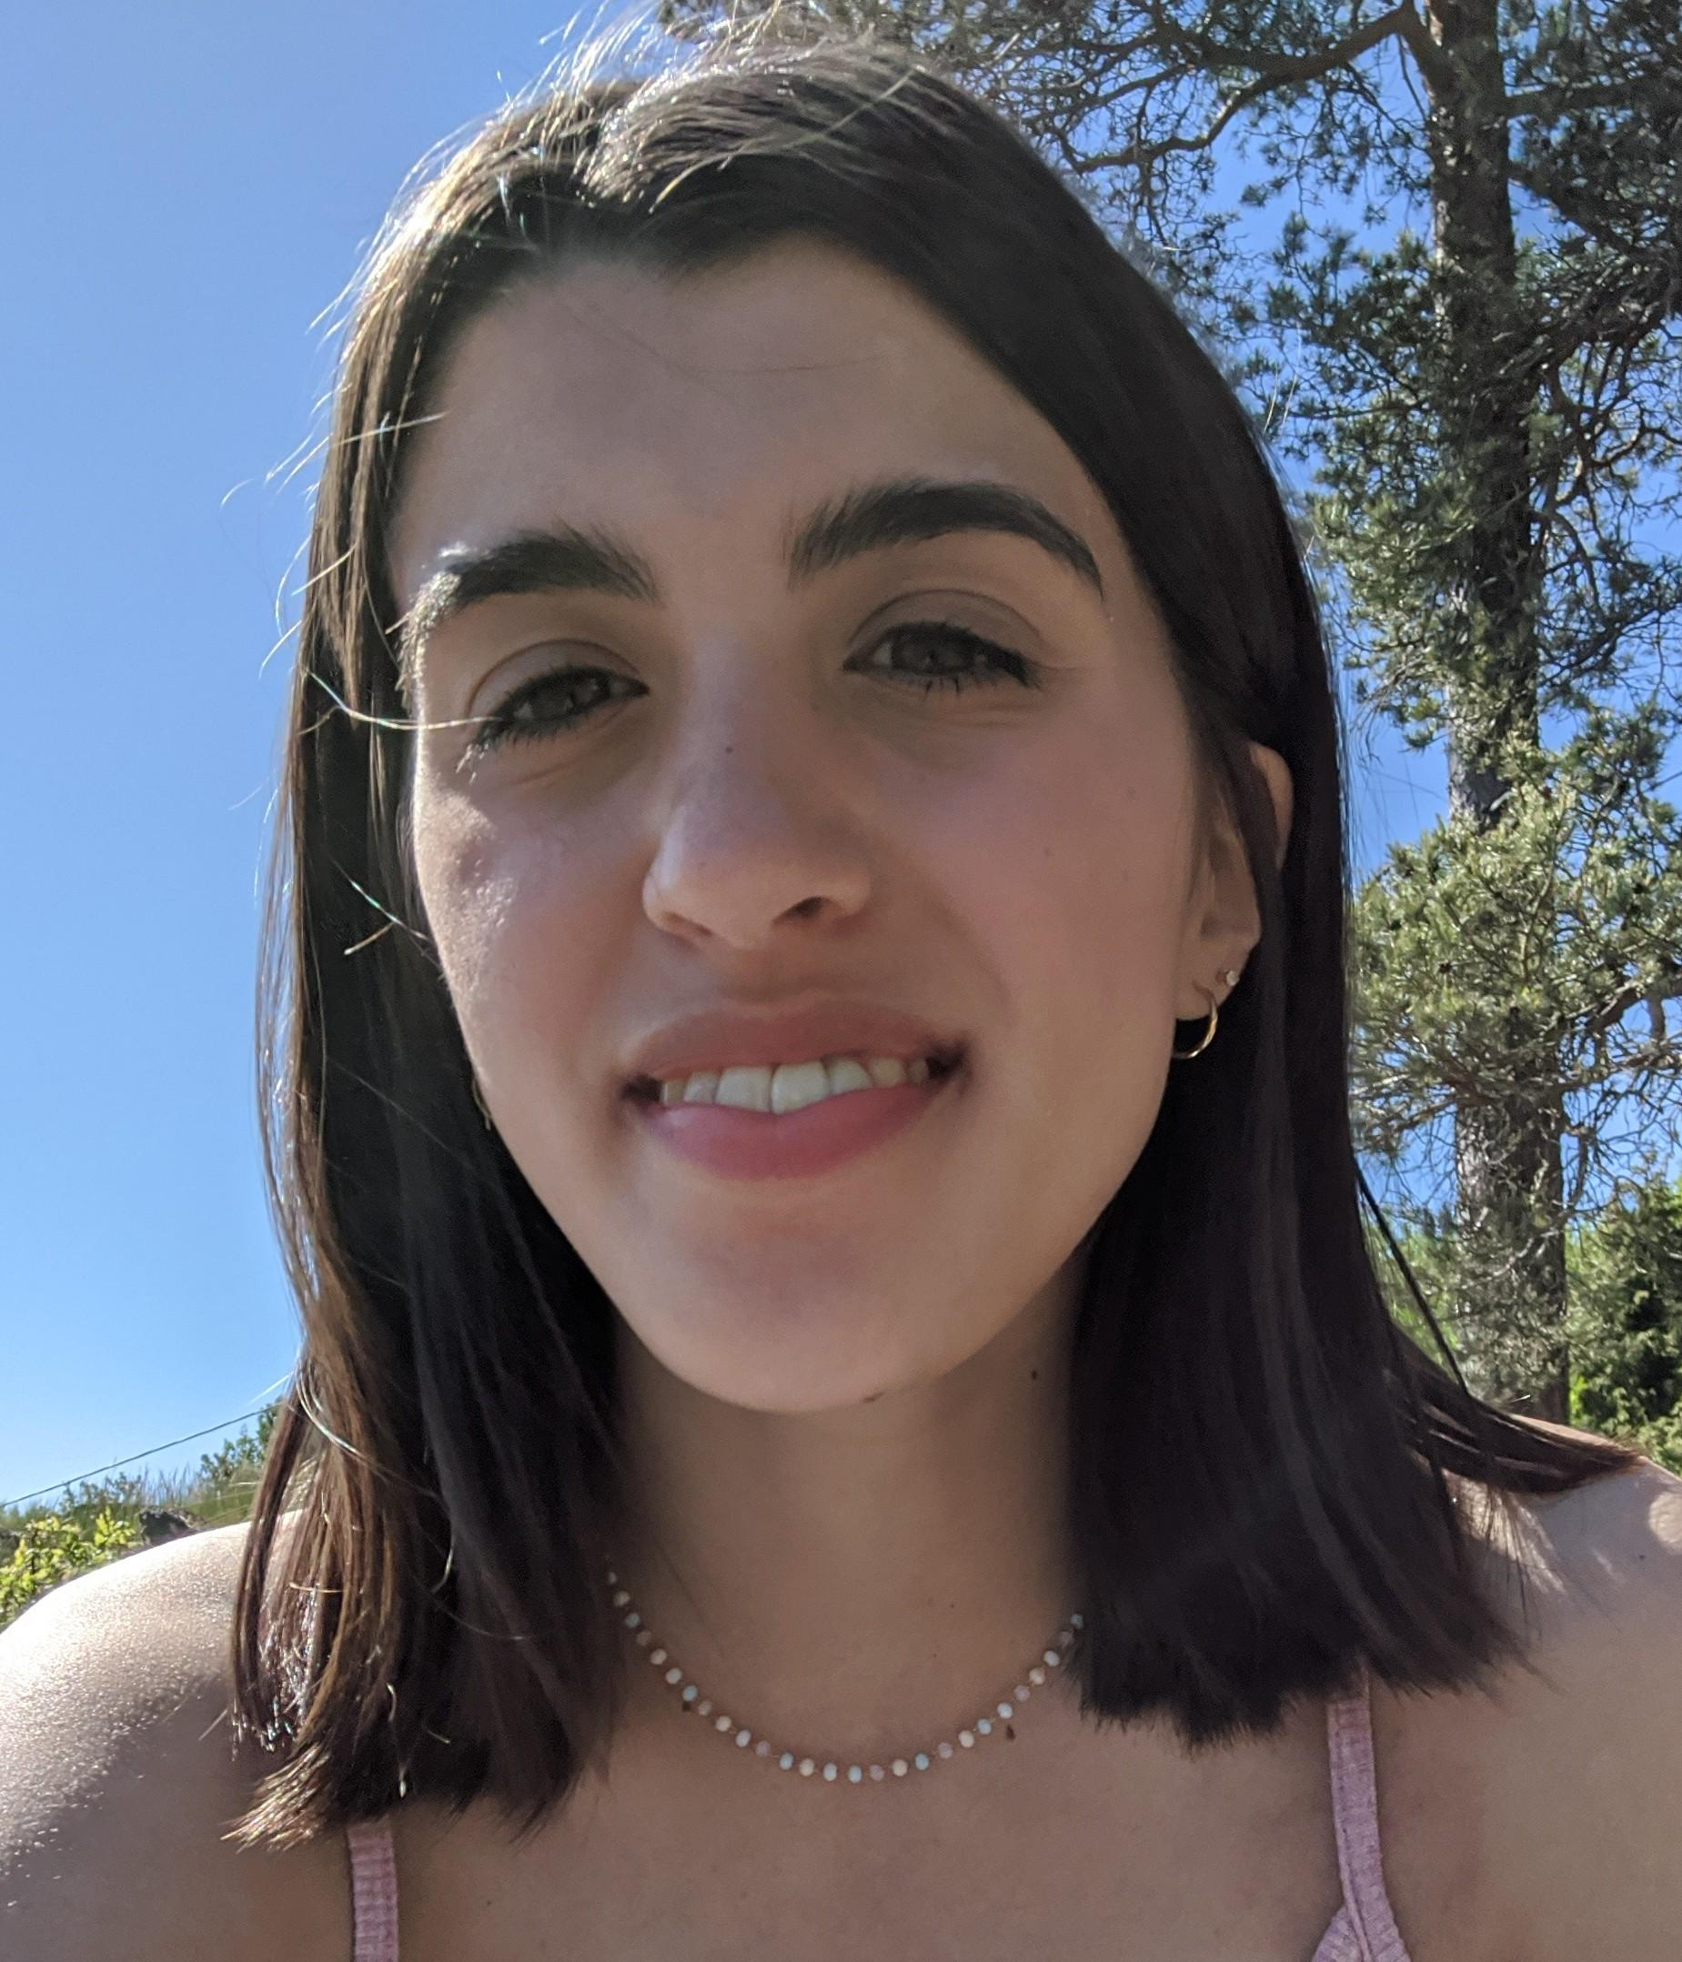
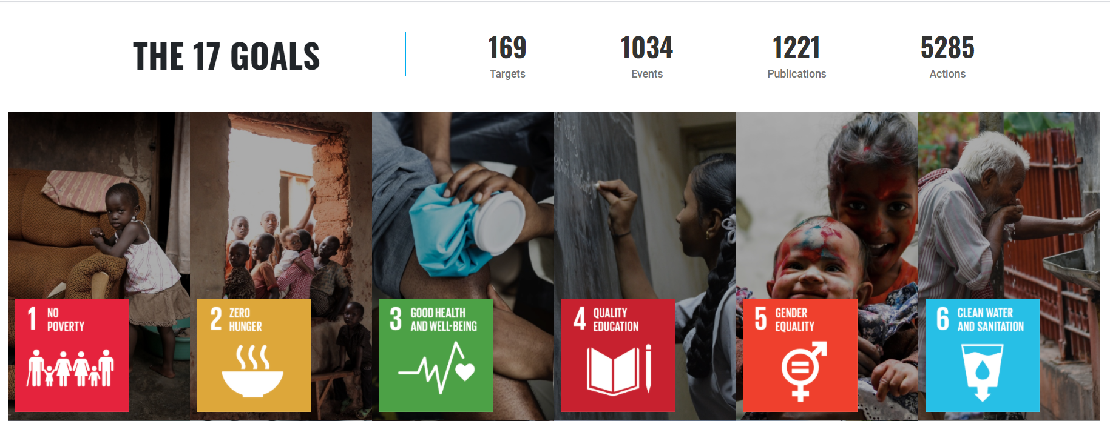
Solution Challenge 2021 Topic:
United Nations Goals
Your Solution Challenge 2021 project must align with one of the 17 United Nations Goals listed here
more!!
Notes:
(click on the link)
(explore one goal in particular and show webpage for individual goal)

Slide 21



United Nations Goals
If you can, try to pick 1 to 3 UN Goals that look interesting to you from the page while we visit it together
Notes:
(click on the link)
(explore one goal in particular and show webpage for individual goal)
Pick a few that look interesting to you, things you might be passionate about.

Slide 22
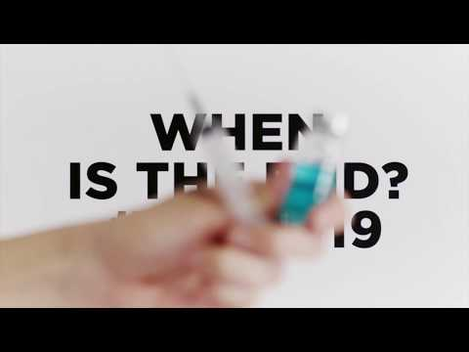
Notes:
I want to give an example of a previous finalist from this year.The project is named CoronAI.

Slide 23

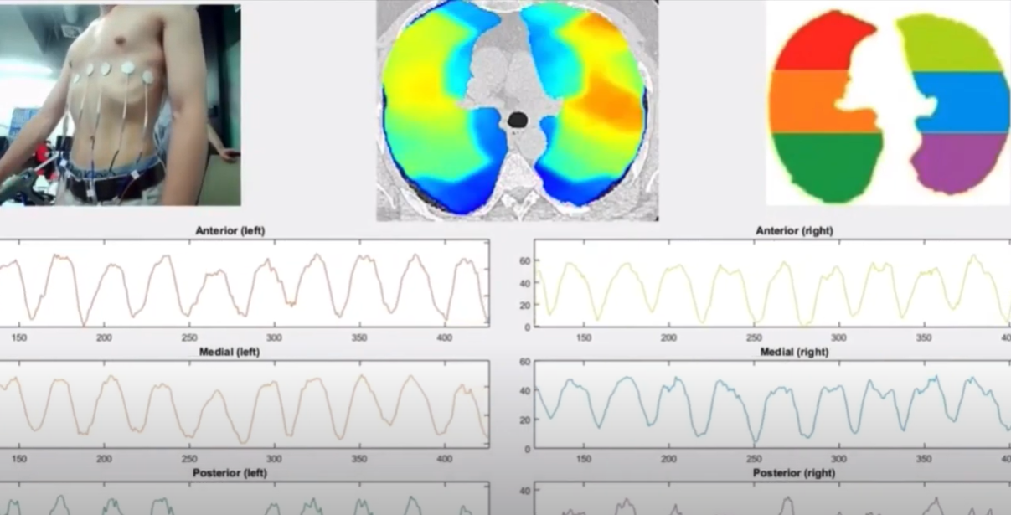
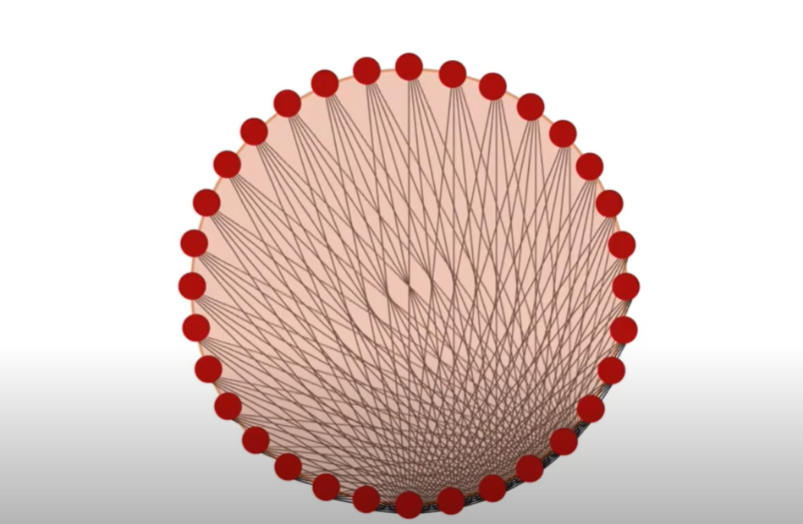
CoronAI
Notes:
In the CaronAI video
The teams project aimed to support healthcare workers during the beginning of the pandemic. This solution was developed to improve treatment times, and treatment accuracy for patients who are experiencing COVID-19 symptoms by using electric impedance tomography.
They used used a velcro band, raspberry pie, sensors, and a machine learning program to interpret data!
The team from University of California Berkeley was invited to present in the Solution Challenge Demo Day 2020.

Slide 24


Identifying a Problem
“What problems or challenges do you face daily?”
Ask:
Professors
Local businesses
Non-profit orgs
Friends & Family
Notes:
As paradoxical as it might seem, it is important to think of a good problem. A good problem will help you stay on track, inspire others, and ultimately create an amazing solution.
“What is good problem to solve?”
If you already have an idea that’s great, if not i’m here to help you!
A common question that I like to ask myself is: “What problems or challenges do I, or possibly others face daily?” this will help you with the first steps of finding a problem of interest.
Also ask professors, Local Businesses, Non-profit organizations, and Family and friends for more ideas!
And just a reminder: remember to check the United Nations goals that leilani mentioned to see if the problem and possible solution falls in the category of a certain topic.
(Michael Scherrer)

Slide 25

Example:
Ask your professor these questions:
Where do you spend most of your time at work (this can be virtual)?
What do you find most difficult in your job?
What tools do you wish you had available?
Source: DSC Solution Challenge: How to identify a problem (great video)
Notes:
Transition: after interviewing a couple of people, you may have found some good problems. Next is Tuan to help define your solution!
(Michael)

Slide 26
Defining Your Solution
(Tuan)
The best thing you can do to help define your solution is to
clearly define the problem you are trying to solve.
Skipping over the problem-definition step and trying to build a solution right away will make your project messy and confusing.
We still have plenty of time before the Solution Challenge, so let’s focus on finding problems and defining them, together!
Notes:
A lot of students will skip over the problem-definition step and start trying to build a solution right away, and this is where things get messy and confusing, biased, debatable, controversial. We still have plenty of time to work on your project, I advise you to spend more time research your problem.

Slide 27
Defining Your Solution
(Tuan)
After you’ve found a problem in your community, ask the people dealing with the problem some good questions:
What is the problem? Who is dealing with it? Why does it happen? Where does it happen? How does it begin? What would a complete solution look like?
Notes:
Ask or interview people around your community, prepare list of question before-hand, you will probably meet lots of dead-end. Not one time, but many time

Slide 28

Forming a Team
You can have up to 4 members on your team. We recommend
having 4 team members so you have as many smart brains as possible!
Notes:
“You might be thinking, Hey Leilani, me and my friend have already started on a project… do I really need more people?”
“Adding more people will give you more perspectives and give you experience for what the real workforce is.”
In industry you’re given people to work with who you don’t know - you have to learn how to get to know new people
Branch out of your friend group. Working with friends is great, but this is a high-stakes contest, only 3 months to take an idea to a fully-working solution. You want to be working with people who you can work efficiently with and have tough conversations about procrastination and

Slide 29

Forming a Team
Common advice is to elect one member as the team leader.
The leader will coordinate the team, ensure project milestones
are met by agreed-upon dates, etc.
The team leader doesn’t make all the
group’s decisions, they just help
manage the group
Notes:
All the articles we read advised that for small group projects, it’s good to choose a group leader. You can pick who’s the leader by asking everyone who would want the responsibility of coordinating the team’s goals and practicing management skills.
You don’t have to decide just yet! We still have another solution challenge event we’re going to host, where we will give more tips about team building.
The team leader isn’t the president or a dictator, your group can still make decisions together. The leader justs plays a role to help manage your group!

Slide 30
Q&A
5 minutes with Michael, Tuan, Leilani, and guest speaker Danny.
More questions:
tag @Daniel Fiorillo in the Developer Student Clubs - North America Slack and ask him there,
ask us in the PSU-DSC Slack, or
ask your own DSC chapter!
Notes:
We have limited time for a short 5 minute Q&A with Danny from Google! Danny will be your Google mentor throughout the Solution Challenge, and you can book 1-on-1 appointments with him by clicking on his profile in the North America Slack

Slide 31

Brainstorming Challenge!
Remember your 1-3 UN categories of interest from earlier. Now...
Notes:
We have some homework for you all!

Slide 32


Week 1 Project Milestone:
Start a Solution Brainstorming thread or participate in a discussion about Solution Challenge project ideas in your DSC chapter related to the UN Goals you chose. (Example Slack/Discord message 2 slides down)
Notes:
Every
Go out in your own DSC chapter and get your friends talking about ideas they might have related to the UN Goals!

Slide 33


Week 1 Bonus Challenge:
Contact at least one person in your community and
ask to interview them.
Professors
Local businesses
Non-profit orgs
Friends & Family
Notes:
As a bonus challenge, go out in your community and ask some people if you can interview them!
Remember, to be eligible, you must register with your school’s DSC. If your school doesn’t have a DSC, you can join ours
(Michael Scherrer)
Bonus Challenge Contest: Chance to Win a Google Backpack!
1. Sign up to your school’s DSC (or the PSU DSC).
2. Contact at least one person in your community
and ask to interview them about
their daily life or work. This person
should be related to the UN Goals
you picked if possible!

Slide 34
Week 1 Contest:
Chance to Win a Google Backpack!
Sign up to your school’s Developer Student Club (For example: PSU DSC).
Complete the Week 1 Project Milestone (participate in a Solution Challenge discussion).
Complete the Week 1 Bonus Challenge (contact at least one person in your community and ask to interview them).
Fill out the contest form.
Attend our Solution Challenge Info Session Part 2 where we will select a winner!
Notes:
I don’t know about you all, but I’ve been in need of a cool new backpack.

Slide 35
Professors
Local businesses
Non-profit orgs
Friends & Family
Notes:
As a bonus challenge, go out in your community and ask some people if you can interview them!
Remember, to be eligible, you must register with your school’s DSC. If your school doesn’t have a DSC, you can join ours
Most importantly..Have fun!
(Michael Scherrer)

Slide 36
Example Slack/Discord Message
“ Hi Everyone!
The Solution Challenge 2021 is coming up, and the topic of this year’s challenge is to solve a problem related to the United Nations humanitarian goals. I would like to start a discussion in our DSC …...”
Notes:
Message transcript:
Hi Everyone!
I’m planning on participating in the Solution Challenge 2021! I’m interested in creating a Solution based on the UN goals of [gender equality or reducing inequalities in society], and I’d like to meet people who are interested in solving similar UN goals for the Solution Challenge! Message me if you’d like to collaborate!

Slide 37
Thank You - Join the PSU DSC!
If you haven’t already, join our DSC (PSU students and students who don’t have a local DSC)! We need motivated, excited students like you!
Become a member of the PSU DSC!
We also need dedicated students interested in learning and teaching technology and programming to be Technical Leads at the PSU DSC:
Apply to become a Tech Lead (Marketing Lead also available)!

